Slide 1
Project Schedule Optimization
Microsoft Project 2013
Lesson 13

Slide 2
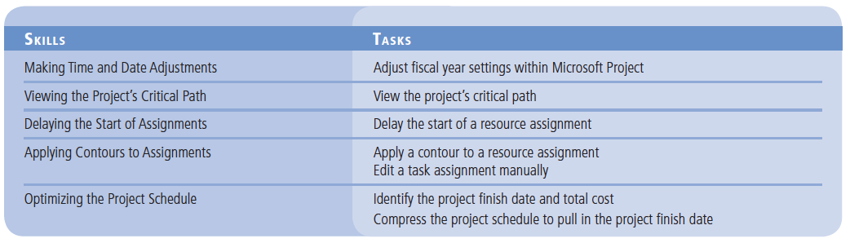
Objectives

Slide 3
Software Orientation
The Calendar Options, located in the Schedule section of the Project Options dialog box, are used to provide basic time values, such as the hours per day or week, fiscal year settings, and the first day of the week.
Keep in mind that the Calendar tab has nothing to do with Microsoft Project’s base, project, resource, or task calendars. The settings on the Calendar tab affect only the time conversions for task durations that you enter into Microsoft Project, not when work can or should be scheduled.

Slide 4
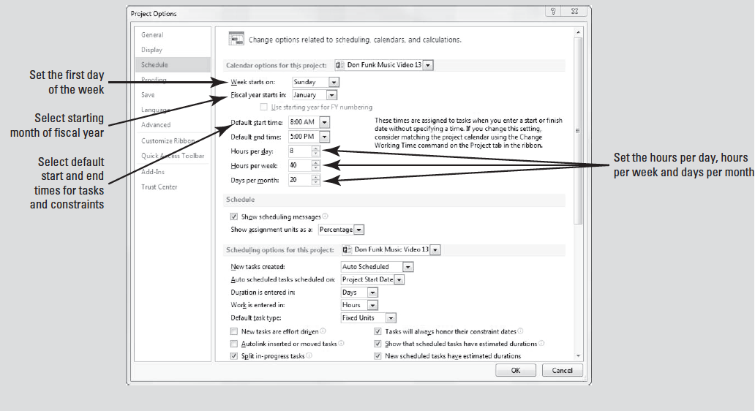
Software Orientation

Slide 5
Making Time and Date Adjustments
As part of its project management capabilities, Microsoft Project has a scheduling engine that works with time.
Because time is always part of the “project equation,” it is critical that the project manager understand the array of time and date settings used by Microsoft Project.

Slide 6
Step by Step: Adjust Fiscal Year Settings within Microsoft Project
GET READY. Before you begin these steps, launch Microsoft Project.
1. OPEN the Don Funk Music Video 13M project schedule.
2. SAVE the file as Don Funk Music Video 13.
3. On the Gantt Chart, drag the divider bar (between the table portion and the graph portion of the Gantt Chart) to the right until the Start and Finish columns are visible.
4. On the ribbon, click the File tab and then select Options. In the Project Options dialog box, select Schedule.

Slide 7
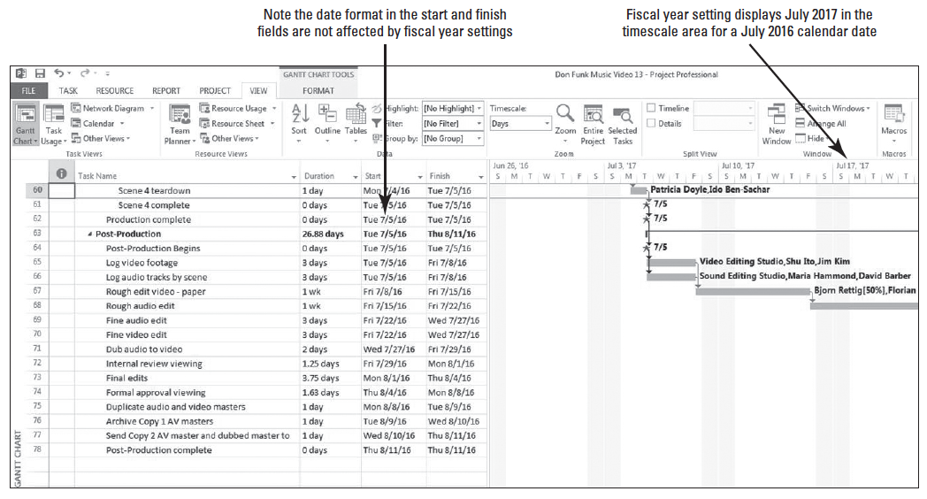
Step by Step: Adjust Fiscal Year Settings within Microsoft Project
5. In the Calendar Options area, click the Fiscal year starts in: box, select July, and then click OK to close the Options dialog box.
6. [Press the F5 key.] In the ID box, type 60 and click OK. Your screen should look similar to the figure below.
Notes:
Another Way: You can restore the calendar year format by returning to the

Slide 8
Step by Step: Adjust Fiscal Year Settings within Microsoft Project
When you select the starting month of the fiscal year, Microsoft Project reformats the dates on the Gantt Chart timescale to use the fiscal year, not the calendar year. The months of July–December 2016 now show a 2017 year to reflect that the 2017 fiscal year runs from July 1, 2016, through June 30, 2017.
7. Click the Undo button twice to restore the dates to the calendar year format.
8. Drag the divider back to the right edge of the Duration column.

Slide 9
Step by Step: Adjust Fiscal Year Settings within Microsoft Project
9. SAVE the project schedule.
PAUSE. LEAVE Project open to use in the next exercise.
In this exercise, you changed the timescale view to accommodate a fiscal year–any 12 consecutive month period defined for accounting purposes–rather than a calendar year–a 12-month period from January to December.
Using a fiscal year timescale is most appropriate if there are stakeholders who are accustomed to analyzing information in a fiscal year format. Otherwise, use the calendar year format.

Slide 10
Step by Step: Adjust Fiscal Year Settings within Microsoft Project
There are many other options for controlling time in Microsoft Project through the Calendar options of the Project Options dialog box.
You use the Calendar options to define basic time values, such as how many hours a day or a week should equal, or how many days should equal one month.
You can also control other time settings, such as which day is the first day of the week (this varies from country to country).
The Calendar options can be confusing, however, because it has nothing to do with Microsoft Project’s base, project, resource, or task calendars. (You control these calendars through the Change Working time dialog box on the Project tab.)

Slide 11
Step by Step: Adjust Fiscal Year Settings within Microsoft Project
The Calendar settings affect only the time conversions for task durations that you enter into Microsoft Project, such as how many hours equal one day–not when work can be scheduled.
For example, if your project is planned for 10 hours a day, 5 days per week, set the hours per day to 10 and the hours per week to 50.
The Default Start Time and Default End Time settings on the Calendar tab can also be confusing.
These settings are not related to working time values for calendars. Rather, the Default Start Time and Default End Time settings have a very specific purpose.

Slide 12
Step by Step: Adjust Fiscal Year Settings within Microsoft Project
These settings supply the default start and end time for task constraints or for actual start and finish dates in which you enter a date but do not include a time.
For example, if you enter a Must Start On constraint value of January 14, 2016, for a task but do not specify a start time, Microsoft Project will use the Default Start Time value that is set on the Calendar tab.

Slide 13
Viewing the Project’s Critical Path
One of the most important parts of the project schedule is the project’s critical path.
The critical path is the series of tasks that affect the project’s end date.

Slide 14
Step by Step: View the Project’s Critical Path
USE the project schedule you created in the previous exercise.
1. On the ribbon, click the View tab, then click the Other Views button in the Task views group. From the list, select More Views. The More Views dialog box appears.
2. In the More Views dialog box, select Detail Gantt, and then click Apply.
3. On the ribbon, click the Tables button, then select Entry.
4. Move the divider bar back to cover the Duration column.
5. [Press the F5 key.] In the ID box, type 54, and then click OK. Microsoft Project displays the Scene 4 summary task at the top of your screen; this is a convenient location to view both noncritical and critical tasks.

Slide 15
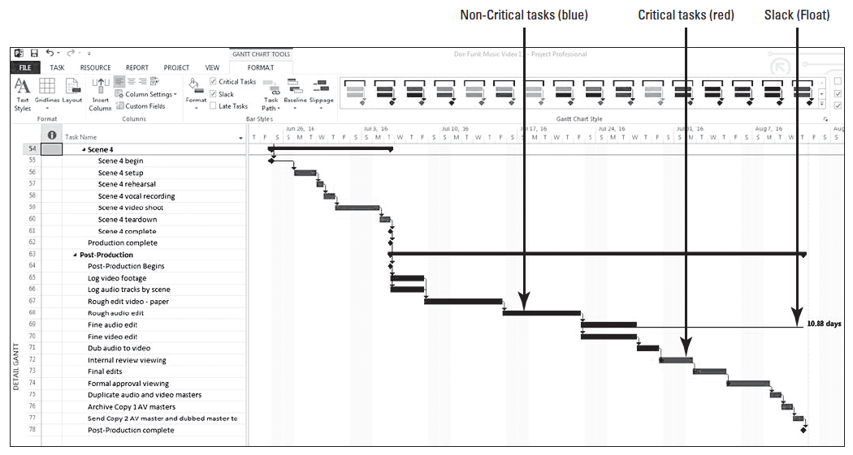
Step by Step: View the Project’s Critical Path
6. On the ribbon, click the Format tab. Click the Slippage button. Select any baseline that does not have a date. Microsoft Project removes the slippage lines from in front of the tasks. Your screen should look similar to the figure below.

Slide 16
Step by Step: View the Project’s Critical Path
In the Detail Gantt view, noncritical tasks appear in blue and critical tasks are in red. In this view, you can also see some tasks that have slack (float). A thin teal line represents the total slack for a given task. Why does the critical path seem to stop in the middle of the project? The answer lies in the total slack.
7. On the ribbon, click the View tab, click the Tables button, and then click Schedule. The Schedule table appears in the Detail Gantt view.
8. Drag the divider bar to the right until all columns in the Schedule table are visible, then auto-fit all the columns until you see all information easily.

Slide 17
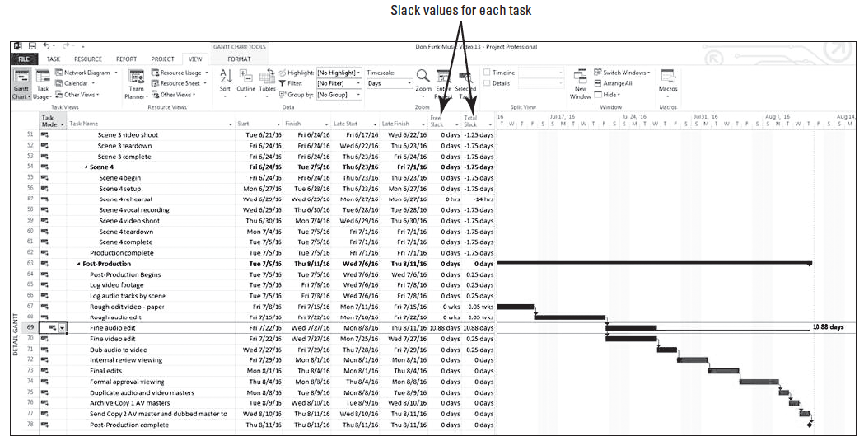
Step by Step: View the Project’s Critical Path
9. [Press the F5 key.] In the ID box, type 69 and click OK. Your screen should look similar to the figure below.

Slide 18
Step by Step: View the Project’s Critical Path
Review the free slack and total slack for each task.
Recall from Lesson 4 that free slack is the amount of time the finish date of a task can be delayed before the start of any successor task is affected.
Total slack is the amount of time the finish date on a task can be delayed before the completion of the project will be delayed.
A task may have total slack, free slack, or both. Slack can be a positive value, negative value or a value of zero.

Slide 19
Step by Step: View the Project’s Critical Path
10. Drag the divider bar back to the left to show just the Task Name column. Select tasks 54 through 78.
11. On the ribbon, in the Zoom group, click Selected Tasks.
12. On the ribbon, click the File tab and then click Options. Select Advanced, and then scroll to the bottom of the window until you reach the Calculation options for this project: section.

Slide 20
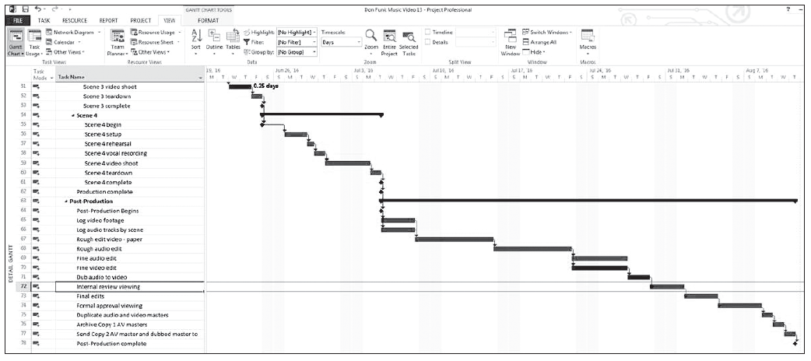
Step by Step: View the Project’s Critical Path
13. Select the Calculate multiple critical paths check box near the bottom of this dialog box, and then click OK. Microsoft Project reformats the tasks in the remaining scenes and the Production phase to show a clearer picture of the critical path. Your screen should look similar to the figure below.

Slide 21
Step by Step: View the Project’s Critical Path
14. On the Quick Access Toolbar, click the Undo button. Microsoft Project reverts to the single critical path for the project.
15. On the ribbon, click the View tab if necessary, then click the Tables button, and then click Entry.
16. Drag the vertical divider bar to the right of the Duration column.
17. SAVE the project schedule.
PAUSE. LEAVE Project open to use in the next exercise.

Slide 22
Step by Step: View the Project’s Critical Path
In this exercise, you reviewed the critical path of your project schedule and the free and total slack for some of the tasks.
One of the most important factors that should be monitored in any project schedule is the project’s critical path.
Keep in mind that “critical” does not refer to the importance of these tasks in relation to the overall project, but rather to how their scheduling will affect the project’s finish date.
As a project manager, it is very important for you to understand how changes in schedule, resource assignments, constraints, etc., will affect this key series of tasks.
After a task on the critical path is complete, it is no longer critical, because it can no longer affect the project finish date.
During the life of the project, it is normal that the critical path will occasionally change.

Slide 23
Delaying the Start of Assignments
If more than one resource is assigned to a task, you may not want all the resources to start working on the task at the same time.
You can delay the start of work for one or more resources assigned to a task.

Slide 24
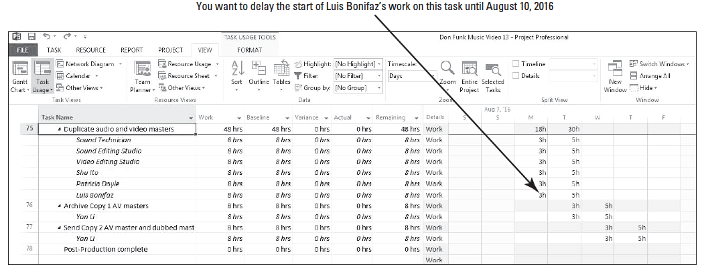
Step by Step: Delay the Start of a Resource Assignment
USE the project schedule you created in the previous exercise.
1. On the ribbon, click the View tab, and then click Task Usage. The Task Usage view appears.
2. [Press the F5 key.] Type 75 in the ID box, and then click OK. Microsoft Project displays the “Duplicate audio and video masters” task. Your screen should look similar to the figure below.

Slide 25
Step by Step: Delay the Start of a Resource Assignment
Luis Bonifaz will inspect the final copies of the masters, so you want to delay his work on this task until Wednesday, August 10, 2016.
3. In the Task Name column, double-click the name of the resource Luis Bonifaz. The Assignment Information dialog box appears. You can also click on the name of the resource, then click Resource tab and select the Information button.
4. Click the General tab if it not already selected.

Slide 26
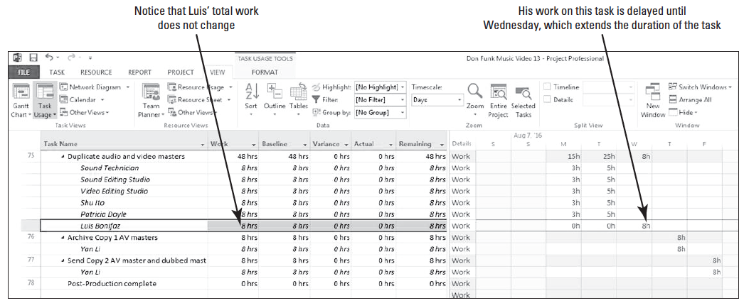
Step by Step: Delay the Start of a Resource Assignment
5. In the Start box, type or select 8/10/16, and then click OK to close the Assignment Information dialog box. Microsoft Project adjusts Luis Bonifaz’s assignment on this task so that he works eight hours on Wednesday. The other resources assigned to this task are not affected. Your screen should look similar to the figure below.

Slide 27
Step by Step: Delay the Start of a Resource Assignment
6. SAVE the project schedule.
PAUSE. LEAVE Project open to use in the next exercise.
In this exercise, you delayed the start of work for a resource assigned to a task.
You can delay the start of work for any number of resources assigned to a task.
However, if you need to delay the start of work for all resources on a particular task, it is better to just reschedule the start date of the task (rather than adjusting each resource’s assignment).

Slide 28
Applying Contours to Assignments End of Part1
You can control the amount of time a resource works on a task by applying a work contour.
A contour describes the way the resource’s work is distributed over time.
To optimize your project schedule, you can apply a predefined contour to a task’s assignments.

Slide 29
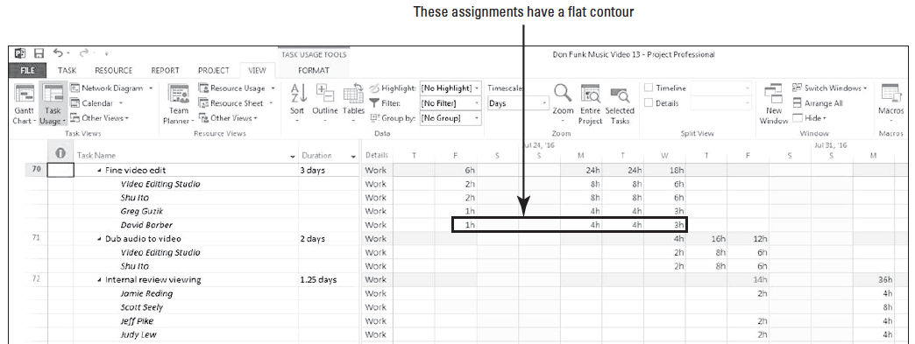
Step by Step: Apply a Contour to a Resource Assignment
USE the project schedule you created in the previous exercise.
1. [Press the F5 key.] Type 70 in the ID box, and then click OK. Microsoft Project scrolls to Task 70.
2. On the ribbon, click the Tables button, select the Entry table and bring the center divider to the left so the duration column is the last one visible. Your screen should look similar to the figure below.

Slide 30
Step by Step: Apply a Contour to a Resource Assignment
This task has four resources assigned to it.
The time-scaled data illustrates that two of the four resources are scheduled to work on this task for two hours the first day, eight hours the next two days, and six hours the last day.
The last two resources, Greg Guzik and David Barber, are only working on this project half-time.
All these assignments have a flat contour–Microsoft Project schedules their work based on a regular rate of eight hours per day. (The resources only work a portion on the first day because they are scheduled on another task.)

Slide 31
Step by Step: Apply a Contour to a Resource Assignment
This is the default work contour type that Microsoft Project uses when scheduling work.
You want to change Greg Guzik’s assignment on this task so that he starts with a brief daily assignment and increases his work time as the task progresses. He will still be working on the task after the other resources have finished their assignments.
2. In the Task Name column under Task 70, double-click the row heading cell of Greg Guzik. The Assignment Information dialog box appears.
3. Click the General tab, if it not already selected.

Slide 32
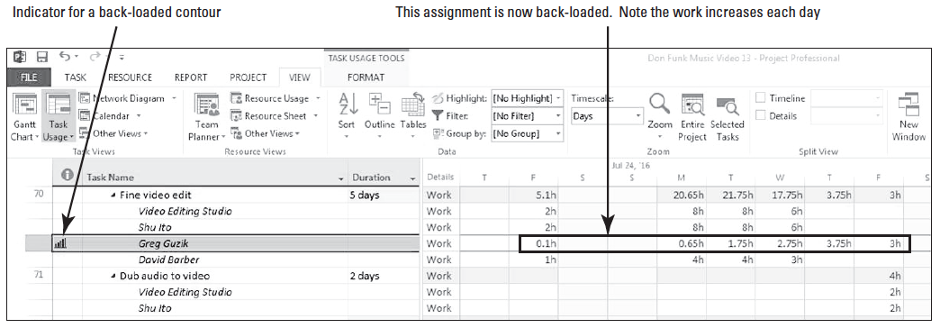
Step by Step: Apply a Contour to a Resource Assignment
4. In the Work contour box, select Back Loaded, and then click OK to close the Assignment Information dialog box. Microsoft Project applies the contour to Greg Guzik’s assignment and reschedules his work on the task. Scroll your screen so that you can see all of Greg’s planned work on this task. Your screen should look similar to Figure 13-9.

Slide 33
Step by Step: Apply a Contour to a Resource Assignment
5. Point to the contour indicator in the Indicators column. Microsoft Project displays a ToolTip describing the type of contour applied to this assignment. See note on page 264.
6. SAVE the project schedule.
PAUSE. LEAVE Project open to use in the next exercise.
In this exercise, you applied a predefined work contour to an assignment.
A contour determines how a resource’s work on a task is scheduled over time.
In general, predefined contours describe how work is distributed over time in terms of graphical patterns.
Notes:
Troubleshooting: Note that applying a contour to this assignment caused the overall duration of the task to be extended. If you do not want a contour to extend a task’s duration, you need to change the Task Type (on the Advanced tab of the Task Information dialog box) to Fixed Dura- tion before you apply the contour. When you apply a contour after changing to a task type such as fixed duration, Microsoft Project will recalculate the resource’s work value so that he or she works less in the same time period.

Slide 34
Step by Step: Apply a Contour to a Resource Assignment
Some options are Bell, Front Loaded, Back Loaded, Double Peak, and Turtle. Predefined contours work best for assignments where you can estimate a probable pattern of effort.
For instance, if a task might require significant ramp-up time, a back loaded contour might be beneficial, since the resource will be most productive toward the end of the assignment.
Keep in mind that because Greg Guzik’s assignment to this task finishes later than the other resource assignments, Greg Guzik sets the finish date of the task.
In this situation it would said that Greg Guzik is the “driving resource” of this task because his assignment determines, or drives, the finish date of the task.

Slide 35
Manually Editing a Task Assignment
It is also possible to manually edit the assignment values for a resource assigned to a task rather than applying a contour.
Since the reality is that a project manager does not plan Greg Guzik’s work for 6 minutes (or 0.1h) on 7/22/16, a manual editing of the assignment is necessary.

Slide 36
Step by Step: Edit a Task Assignment Manually
USE the project schedule you created in the previous exercise.
1. In the time-scaled grid area, click the cell at the intersection of Greg Guzik and 7/22/16.
After conferring with Greg, you want to change this assignment to make it more realistic. Greg states that he can work for an hour on the first two days, 3 hours on the next two days and 4 hours on the fifth day to complete his work. Note that you are not changing Greg’s total assigned work on this task, which is 12 hours.

Slide 37
Step by Step: Edit a Task Assignment Manually
2. Type the following hours in the corresponding cells:
7/22/16—1
7/25/16—1
7/26/16—3
7/27/16—3
7/28/16—4
7/29/16—0

Slide 38
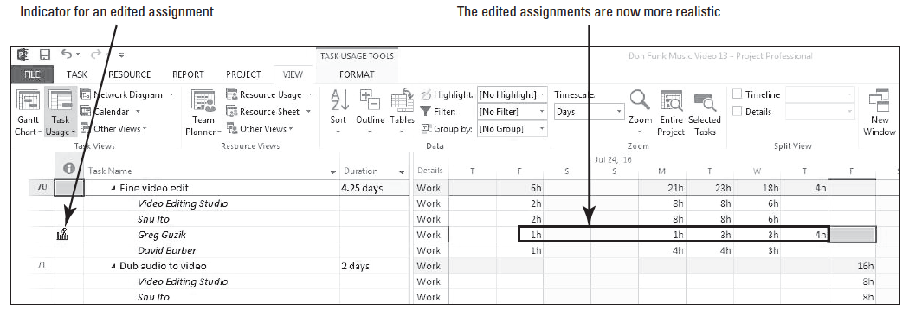
Step by Step: Edit a Task Assignment Manually
3. Point to the contour indicator in the Indicators column. Microsoft Project displays a different ToolTip on this assignment. Notice now that Greg’s assignment is a bit more realistic. Your screen should look similar to the figure below.
4. SAVE the project schedule.

Slide 39
Step by Step: Edit a Task Assignment Manually
PAUSE. LEAVE Project open to use in the next exercise.
In this exercise, you manually edited the assignment for a resource by directly changing the assignment values in the time-scaled grid of the Task Usage view.
You may have noticed that when you deleted the last contoured work day, by entering zero work hours, the tasks after task 70 shifted back to reflect the shortened duration of task 70.
You can use either predefined contours or make manual edits to a resource’s work assignments. How you contour or edit an assignment depends on what you need to accomplish.

Slide 40
Optimizing the Project Schedule
As the work continues on your project, you will be tracking actuals and updating your project schedule.
An important part of project management is verifying that the project has been optimized.
This might mean reducing cost, duration, scope, or any combination of these aspects.
In order to optimize a project schedule, you must first identify and understand the project’s duration, finish date, and total cost.

Slide 41
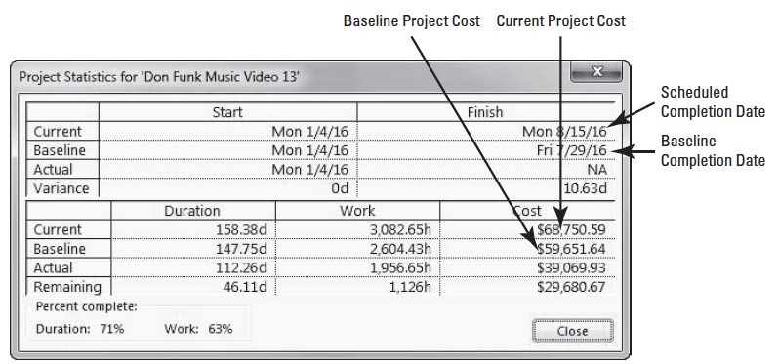
Step by Step: Identify the Project Finish Date and Total Cost
USE the project schedule you created in the previous exercise.
1. On the ribbon, in the Task Views group, click the Gantt Chart button.
2. On the ribbon, click the Project tab, and then click the Project Information button. Click the Statistics button. The Project Statistics dialog box appears. Your screen should look similar to the figure above.

Slide 42
Step by Step: Identify the Project Finish Date and Total Cost
Notice that the Current Finish Date is 8/15/16. This is later than the Baseline Finish Date of 7/29/16.
You have a positive duration variance of 10.63 days, which means you are scheduled to finish more than 10 working days later than planned.
This box also provides the current cost: just over $68,750. This value is the sum of all actual costs to date and the remaining planned task and resource costs in the project. These include actual and planned fixed costs, per-use costs, and the costs of resource assignments.
3. Click Close to close the Project Statistics dialog box.
4. SAVE the project schedule.
PAUSE. LEAVE Project open to use in the next exercise.

Slide 43
Step by Step: Identify the Project Finish Date and Total Cost
In this exercise, you reviewed project details such as the duration, finish date, and total costs.
It is helpful to review this information so that you understand the nature of your project and how it can best be optimized.
Optimizing is adjusting the aspects of the project schedule, such as cost, duration, and scope (or any combination of these), to achieve a desired project schedule result.
A desired result may be a target finish date, duration, or overall cost.

Slide 44
Step by Step: Identify the Project Finish Date and Total Cost
Now let’s look forward to the next exercise. Assume that you have shared the project details from above with the project sponsor.
The sponsor expected that the project would be slightly over budget, but they did not expect that it would be a week or more beyond the agreed finish date.
The current projected budget overrun is acceptable, and can even increase slightly, if the project manager can get the project completed by 8/8/16.

Slide 45
Step by Step: Compress the Project Schedule to Pull in the Project Finish Date
Now that you have reviewed the project details, you will focus on pulling in the project finish date.
USE the project schedule you created in the previous exercise.
1. [Press the F5 key.] In the ID box, type 54 and click OK. Since you need to pull in the project finish date, your focus will be on the critical tasks.
2. Scroll through and review the task list. Note that only tasks 69 and 73 are non-critical. Shortening the duration of non-critical tasks will have no effect on the project finish date. To shorten the project finish date, you must work with the critical tasks.

Slide 46
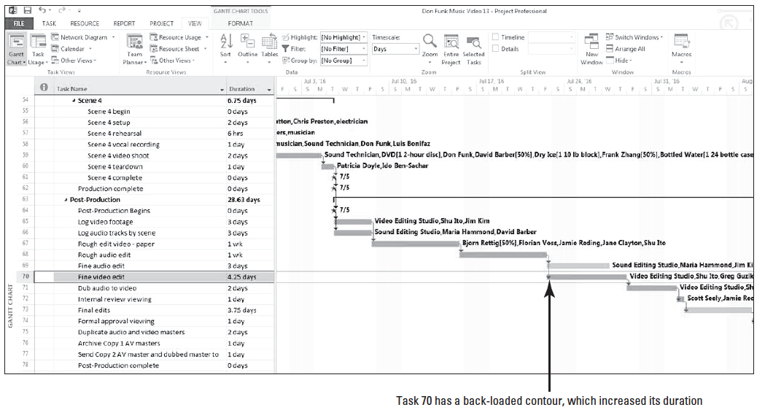
Step by Step: Compress the Project Schedule to Pull in the Project Finish Date
3. If necessary, scroll the Gantt Chart view to the right so that you can see the entire Gantt bar for task 70. Your screen should look similar to the figure below.
Notes:
Recall that in an earlier exercise, you applied a back loaded contour to Greg Guzik’s assignment to this task, lengthening its duration. To leave this assignment contour in place but start subsequent tasks earlier, you will add lead time to Task 71, Task 70’s successor task.

Slide 47
Step by Step: Compress the Project Schedule to Pull in the Project Finish Date
4. In the Task Name column, double-click the name of Task 71, Dub audio to video. The Task Information dialog box appears.
5. Click the Predecessors tab.
6. In the Lag field for the predecessor Task 70, type -25% and [press Enter]. Click OK to close the Task Information dialog box.

Slide 48
Step by Step: Compress the Project Schedule to Pull in the Project Finish Date
Applying a lead time to the task relationship between tasks 70 and 71 causes Task 71 and all successor tasks to start earlier. Entering this lead causes the successor Task 71 to begin when 75% duration of the predecessor Task 70 has elapsed.
Also note that some of the tasks that were critical before you added the lead are no longer critical. This is temporary. Your screen should look similar to the figure on the next slide.

Slide 49
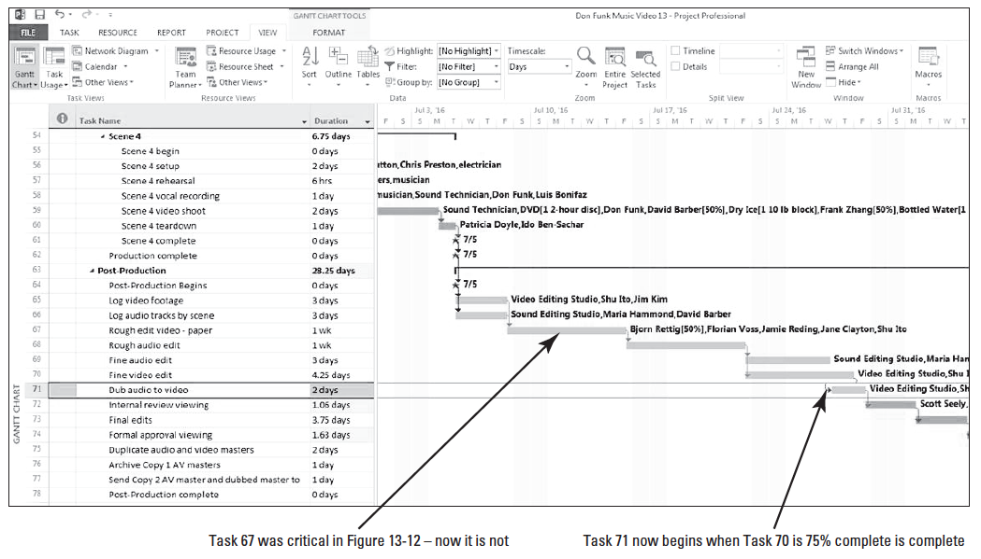
Step by Step: Compress the Project Schedule to Pull in the Project Finish Date

Slide 50
Step by Step: Compress the Project Schedule to Pull in the Project Finish Date
7. Double-click Task 68, Rough Audio Edit. You realize that you can gain some additional time by adjusting the relationship of tasks 67 and 68 since these can be performed at roughly the same time.
8. Click the Predecessor tab if necessary. In the Lag field, type 22d. Click OK. Notice now that some of the tasks are critical again. Your screen should look similar to the figure on the next slide.

Slide 51
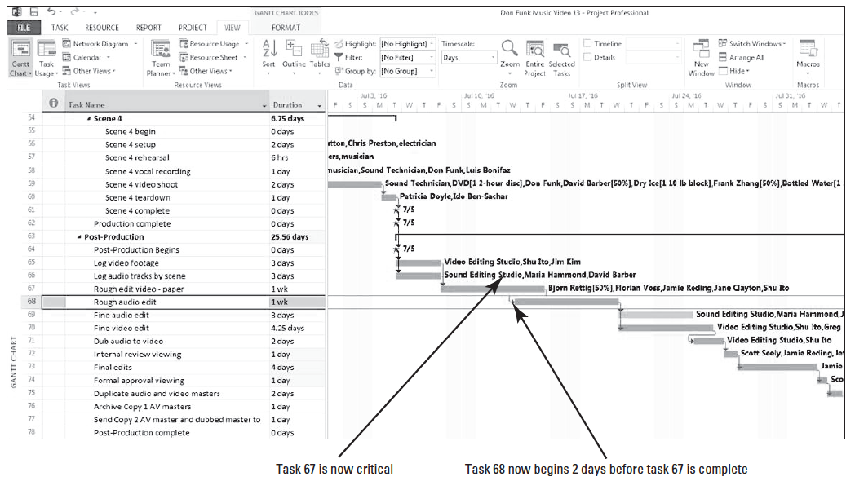
Step by Step: Compress the Project Schedule to Pull in the Project Finish Date

Slide 52
Step by Step: Compress the Project Schedule to Pull in the Project Finish Date
This process is called fast-tracking, which is defined as doing tasks in parallel that were originally planned to be done in series.
You can review the Gantt Chart view (or display the Project Information dialog box) to see that the final task of the project now ends on 8/10/16. This is still about 8 working days later than your desired finish date.
To compress the project duration further, you will apply overtime work to some assignments.

Slide 53
Step by Step: Compress the Project Schedule to Pull in the Project Finish Date
9. On the View ribbon, click the Task Usage button. The Task Usage view appears. Click the Tables button, then select the Usage table.
10. Right-click the Work column heading. On the quick menu that appears, select Insert Column.
11. Type Over, and then select Overtime Work from the list. Microsoft Project inserts the Overtime Work column between the Task Name and Work columns. Drag the divider bar between the table and chart portions of the Gantt Chart to the right until the Duration column is visible. The specific task for which you wish to apply overtime is task 67.

Slide 54
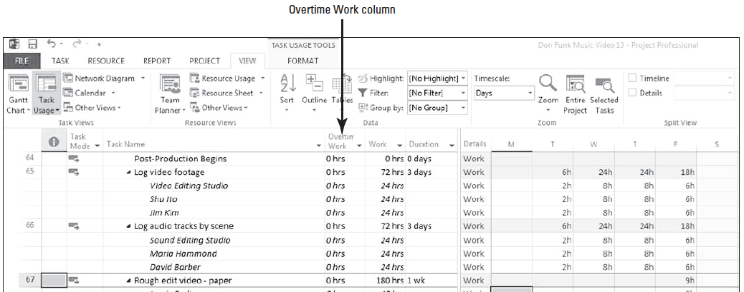
Step by Step: Compress the Project Schedule to Pull in the Project Finish Date
12. [Press the F5 key.] In the ID box, type 67 and click OK. Microsoft Project scrolls the Task Usage view to display the assignments of Task 67. Your screen should look similar to the figure below.

Slide 55
Step by Step: Compress the Project Schedule to Pull in the Project Finish Date
Currently, four of the resources are assigned 40 hours of regular work to this task. Bjorn Rettig is assigned 20 hours of work because his Max Units value is 50%.
To shorten the task’s duration without changing the total work in the task (for each assignment except Bjorn Rettig), you will record that 10 of the 40 hours of work is overtime work.
You will record 5 hours of overtime work for Bjorn Rettig.
13. Click the Overtime Work cell for Jamie Reding, the first resource assigned to Task 67.
14. Type 10 and [press Enter].
15. Repeat steps 13 and 14 for Shu Ito, Florian Voss, and Jane Clayton.
Skip to slide 59
Notes:
Take Note: Entering overtime work for an assignment does not add work to the assignment. Rather, it indicates how much of the work assigned is overtime. Adding overtime work reduces the overall duration of the assignment.

Slide 56
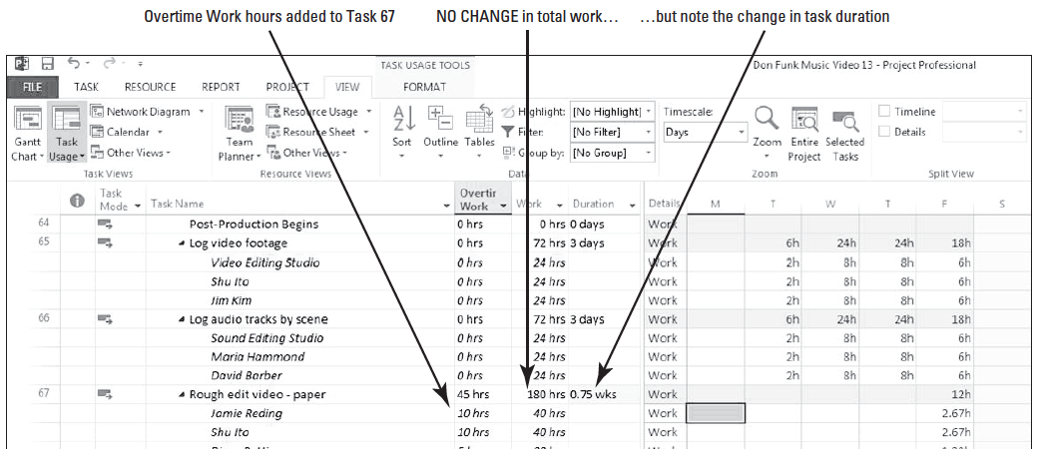
Step by Step: Compress the Project Schedule to Pull in the Project Finish Date
16. Repeat steps 13 and 14 for Bjorn Rettig, except type 5 in the Overtime Work cell. Your screen should look similar to the figure below.

Slide 57
Step by Step: Compress the Project Schedule to Pull in the Project Finish Date
17. On the ribbon, click the Project tab, then click Project Information, and then select the Statistics button. Note the new projected finish date of 8/9/16. Remember the sponsor asked the scheduled be compressed to complete the project no later than 8/8/16–you are almost there.
18. Close the Project Statistics dialog box. Now click the Task tab, and then click the Gantt Chart button.
19. [Press the F5 key.] Type 69 in the ID box, and then click OK. Notice now how Task 69 is no longer critical.
20. Look at Task 76 and its relationship with Task 75. After speaking with your team, you realize that Task 76 can be started one-half day after Task 75 starts. Double-click Task 76.

Slide 58
Step by Step: Compress the Project Schedule to Pull in the Project Finish Date
21. On the Predecessors tab, type 21.5d in the Lag column, and then click OK.
22. On the Project ribbon, click Project Information. Click the Statistics button. The Project Statistics dialog box appears. Note that the new finish date is 8/5/16. CLOSE the Project Information dialog box. The finish date is now before the newly mandated finish date of 8/8/16, which is acceptable to the sponsor. You will stop your project optimization work here.
23. SAVE the project schedule, and then CLOSE the file.
PAUSE. If you are continuing to the next lesson, keep Project open. If you are not continuing to additional lessons, CLOSE Project.

Slide 59
Step by Step: Compress the Project Schedule to Pull in the Project Finish Date
In this exercise, you compressed a project schedule by applying lead time to some tasks and allowing overtime for another task.
Optimizing a project schedule and responding to variance are issues that Microsoft Project cannot automate.
As a project manager, you must know the nature of your projects and how they should be optimized.
As you saw in this exercise, you might need to make trade-offs, such as cutting scope, adding resources, allowing overtime, or adding lead time.

Slide 60
Step by Step: Compress the Project Schedule to Pull in the Project Finish Date
Although you stopped your optimization work when you achieved your desired finish date, keep in mind that once actual work starts, variance will almost certainly appear and the critical path and project finish date are likely to change.
For this reason, properly identifying and responding to variance is a key project management skill.
In previous lessons, only a single critical path per project has been emphasized: the critical path that determines the project finish date. However, as you saw in this exercise, Microsoft Project can identify a critical path within any chain of linked tasks.

Slide 61
Step by Step: Compress the Project Schedule to Pull in the Project Finish Date
This is especially useful when the project is divided into distinct phases. Usually, the critical path within a phase will have a much more distinct line of tasks in it.
Most projects have a specific due date by which they need to be completed. If you want to shorten the duration of the project to make the end date occur sooner, you must shorten the critical path (in project management jargon, this is called “schedule compression”).

Slide 62
Step by Step: Compress the Project Schedule to Pull in the Project Finish Date
In reality, compressing the schedule happens in various ways, but these can be classified into two categories:
Fast-Tracking—Performing two or more project tasks in parallel that would otherwise be done in series, or one right after the other. By overlapping the tasks, more work gets completed in a shorter amount of time.
Crashing—Adding more resources to the critical path tasks. This could take the form of working extra shifts, working overtime, adding more work resources to a task, or outsourcing (paying to have some work done outside the organization).

Slide 63
Step by Step: Compress the Project Schedule to Pull in the Project Finish Date
Prior to starting actual work on the project, it is critical that the project manager closely manage both the critical path and the float (called “slack” in Microsoft Project). This involves:
Knowing the tasks that are on the critical path and being able to evaluate the risk-to-project success if any of the tasks are not completed as scheduled. Any delays in completing tasks on the critical path delay the completion date of the project.
Knowing where the slack is in the project. On a complex project, the critical path may change frequently. Tasks with very little free slack might become critical as the project begins and the actuals start to vary from the schedule. In addition, tasks that had no free slack initially (and therefore were on the critical path) might get free slack as other tasks move onto the critical path.

Slide 64
Skill Summary

